Slide 1
Click Through Rate Prediction W261 – Section 4 Fall 2019 Team 21
Brent Biseda, Katie Mo,
Teddy Fong, Thanh Le
https://exec-ed.berkeley.edu/course/joint-certificate/
Notes:
Thanh

Slide 2
Our Key Question
What feature(s) should we use to create an accurate model to predict who will click on the ads?
This can further help predict revenue generated from the ad.
Notes:
Thanh

Slide 3
EDA: Understanding our data
Shape
39 columns, 36,668,287 rows
26 categorical variables
12 with missing values (approx. 46% of var)
13 numerical variables
11 with missing values (approx. 85% of var)
Notes:
Thanh
use EDA to explain how we make algorithm scalable

Slide 4
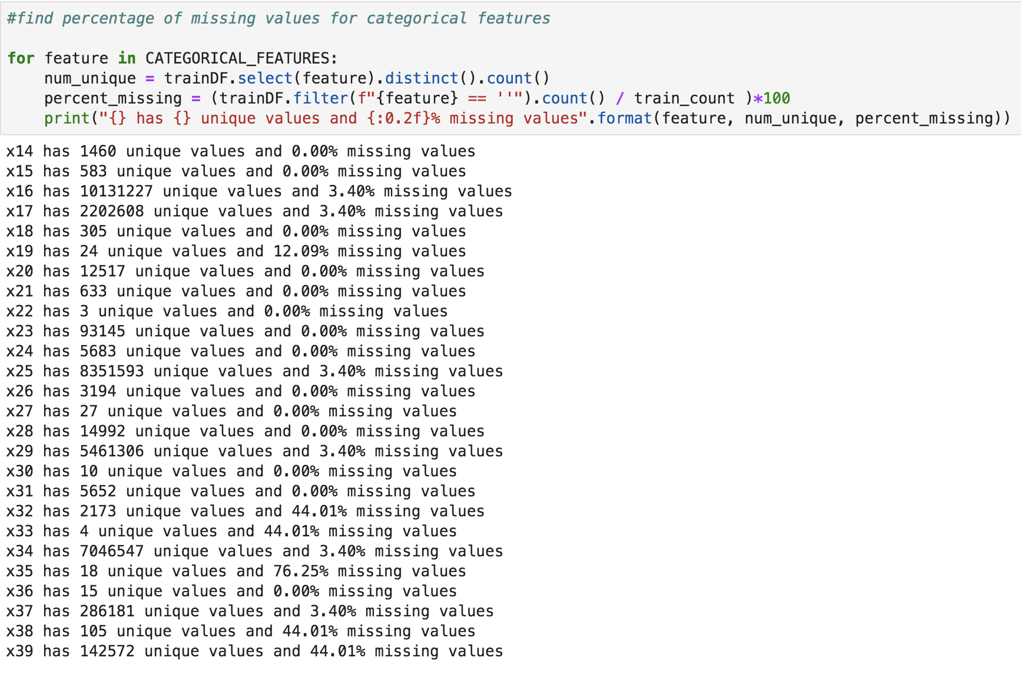
EDA: Understanding our data
Unique values
Notes:
Thanh
use EDA to explain how we make algorithm scalable

Slide 5
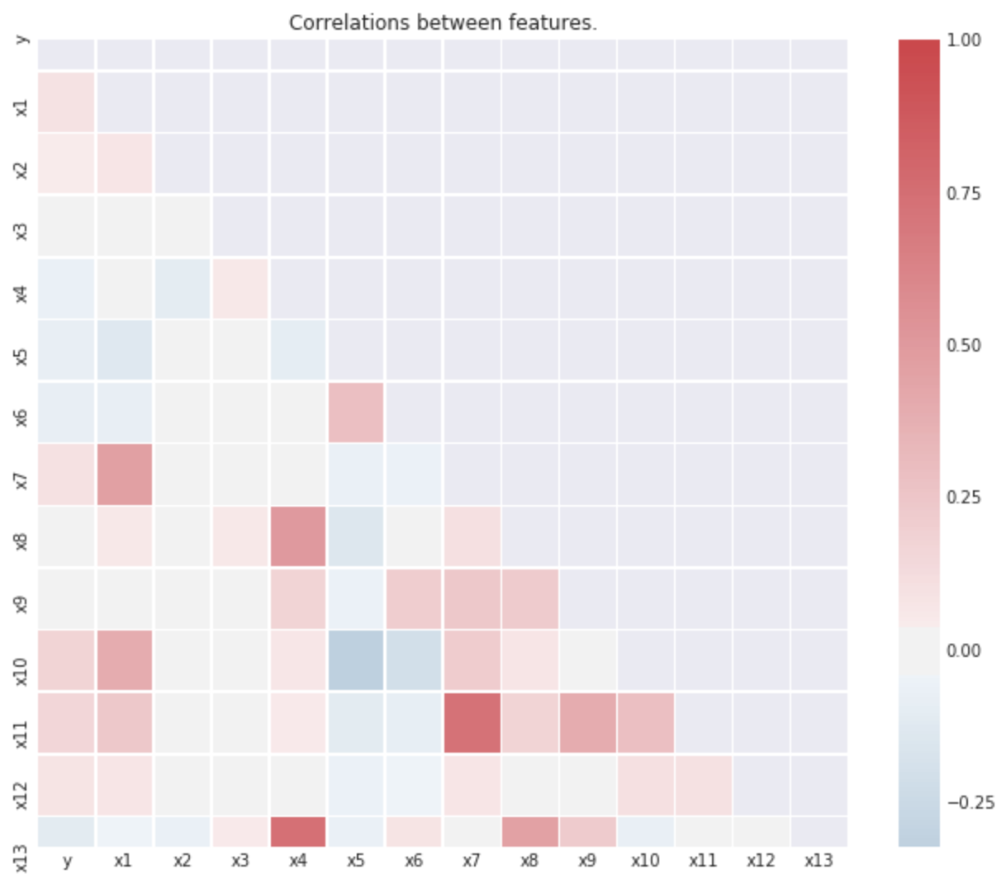
EDA: Understanding our data
Multicollinearity
Notes:
Thanh
use EDA to explain how we make algorithm scalable

Slide 6
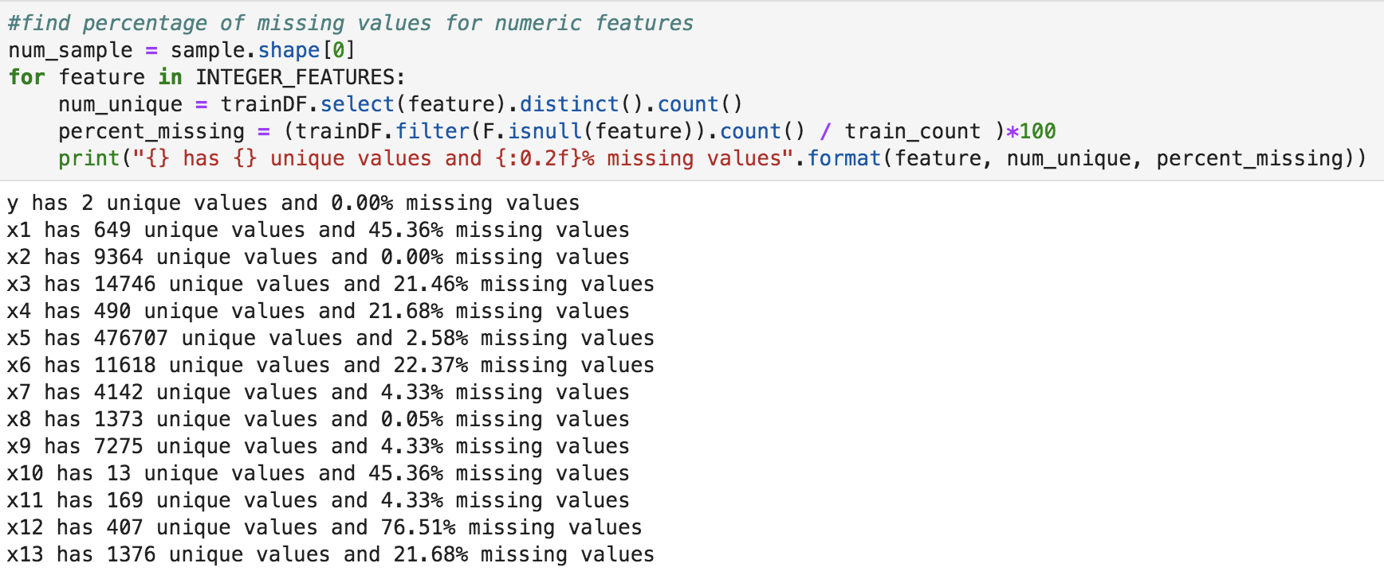
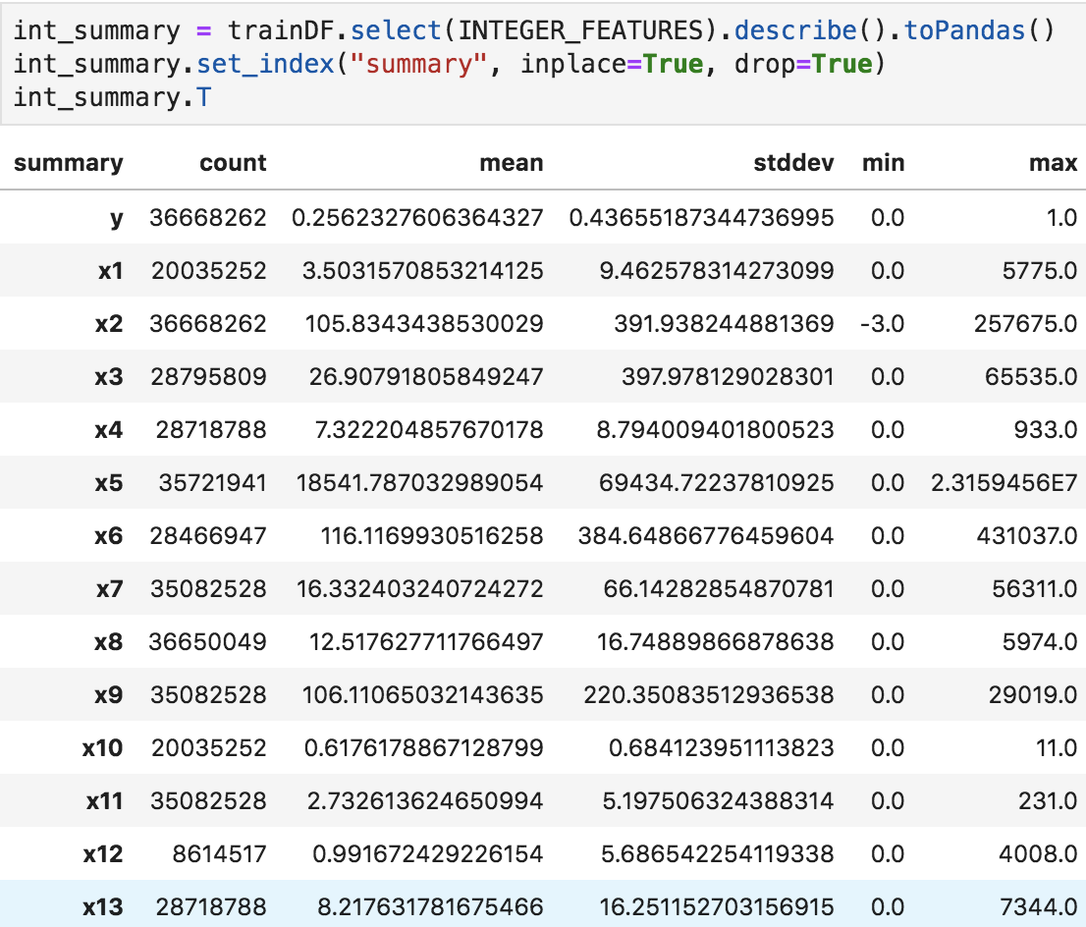
EDA: Understanding our data
Convert all variables to categorical
36M records, but numeric values are all shown to be integers
Notes:
Thanh
use EDA to explain how we make algorithm scalable

Slide 7
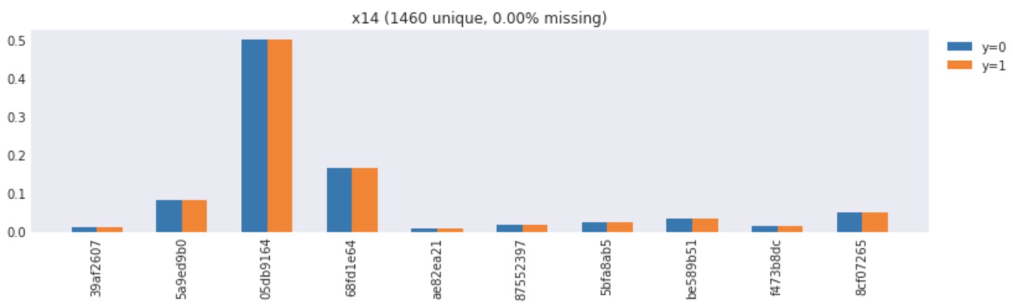
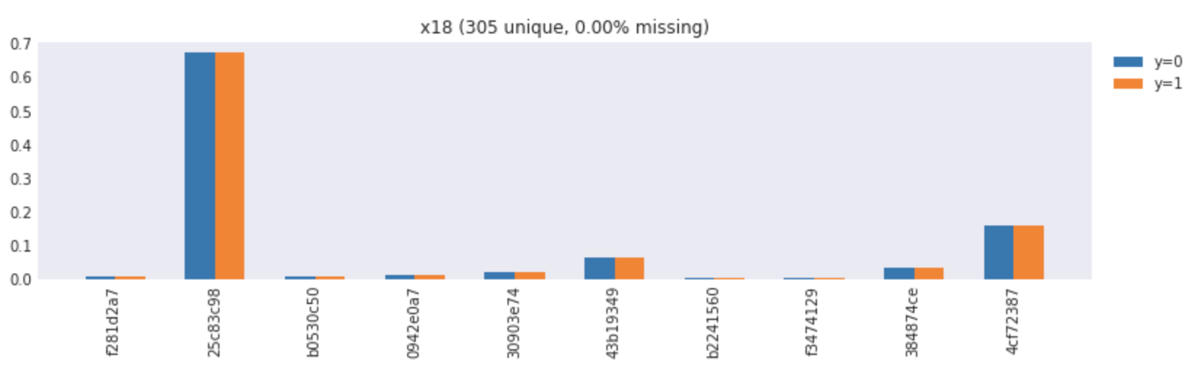
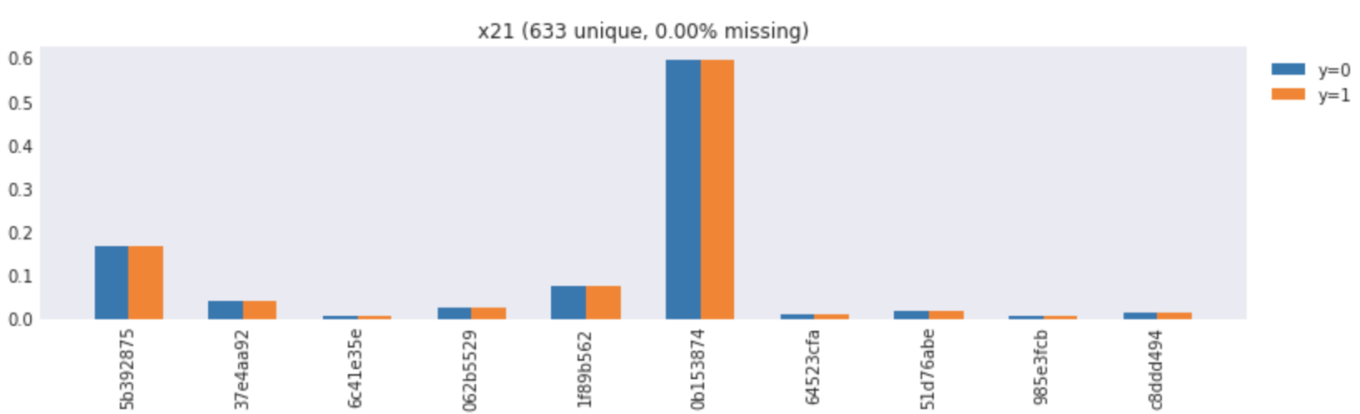
EDA: Understanding our data
Exclude variables
provide no valuable info to differentiate between click (1) and no-click (0)
Notes:
Thanh

Slide 8
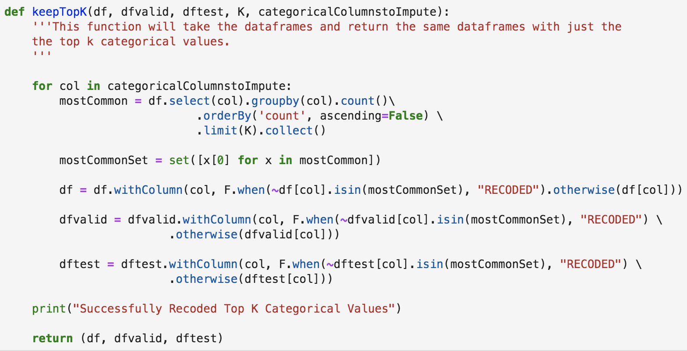
EDA: Understanding our data
Variables with large number of unique values
Transform - Keep top K unique values and “recode” the rest
Notes:
Thanh

Slide 9
EDA: Understanding our data
Impute missing values
impute the most common instance since all are categorical feature
If test data has unseen categorical values
will replace with the empty string and allow the impute function to fill these values
Notes:
Thanh

Slide 10
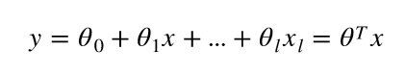
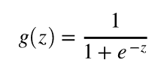
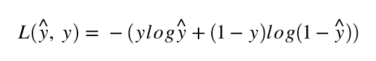
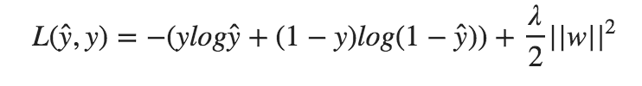
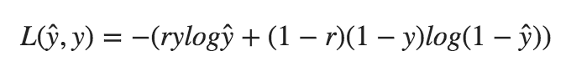
Logistic Regression
Linear model:
Sigmoid function:
Cost function:
with L2 regularization
with class weights
Notes:
Katie
We chose to use logistic regression because it is able to classify a binary discrete outcome. It is a linear model, but the outcome from the linear model is mapped to a probability between 0 and 1 using the sigmoid function. Then a decision boundary is applied in which probabilities above or equal to the threshold becomes the positive class and below the negative class. The cost function for logistic regression is log loss. Mean squared error used in linear regression cannot be used here because it becomes a non-convex problem. The cost function can be thought of two piecewise functions, the left term is the loss for positive, y=1, observations, while the right term is the loss for negative, y=0, observations. Because we have a large number of features, we used L2 regularization to ensure reasonable generalization of our model to unseen data. The additional regularization term in the cost function penalizes coefficients that become too large. Lastly, because we have an imbalanced dataset, we also tried training the logistic regression with class weights. To do this, we calculate a balancing ratio, here labeled as r, which is the ratio of observations in the majority class (class 0) to the total number of observation. This is added to the cost function and it will penalize incorrect predictions of the minority class more than the majority class.
better able to capture the shape of the probability distribution
binary outcome
Optimize with Gradient Descent
Train with Class Weights
MapReduce implementation on toy example

Slide 11
Pipeline
Convert numerical features to categorical features
Drop features that do not have differing class distributions
Keep top 10,000 categories and recode the rest
Impute missing values with the most common value
One hot encoding
Maximum absolute scaling
Logistic regression
Notes:
Katie
Based on our EDA analysis that Thanh has described earlier, we built a pipeline to do a number of preprocessing steps before we get to logistic regression with regularization and class weights. First, we convert numeric features to categorical features. Then, we dropped the 3 features that we found did not have differing distributions for the 10 top categories of each class. Next, for 7 of the features with an extreme number of unique values, we kept only the top 10,000 categories, and combined the rest into a new recoded category. We then imputed any missing values to take on the most common value for that feature. In the case that the missing values were the most common value, they would take on a new category which we labeled with the string “empty”. From there, we applied one hot encoding to transform the categories of each feature to new columns, while omitting the last category. Although we did not necessarily need to since our data was all categorical data and is now entirely one hot encoded with 0 and 1s, in the case that numeric data were added in the future, we would need to scale the data for regularization. We chose maximum absolute scaling because it is able to preserve the sparse representation of our dataset and allow us to store the data with less memory. Once these steps have been performed, we are now able to begin modeling using logistic regression.

Slide 12
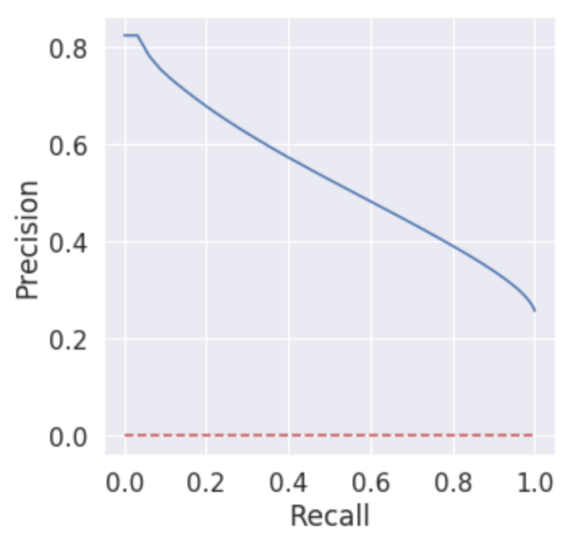
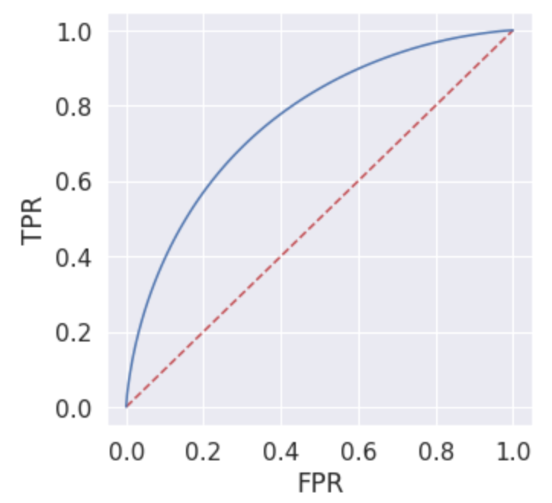
Evaluating Model Performance
Receiver Operating Characteristic (ROC)
Precision-Recall
Curve
Chose Area under the Precision-Recall curve as our primary evaluator due to imbalanced data set
Notes:
Teddy
Model performance metrics were one of the key parts of our analysis. We had to consider a variety of metrics, but we ended up choosing to use the precision-recall curve plot. The precision-recall curve works effectively on imbalanced data sets and we can tune our model by adjusting our recall to determine an acceptable precision. In short, it met the trade-off between the true positive rate and the positive predictive value for CTR prediction
We also considered the ROC curve which has some similarities to the Precision-REcall curve. It would have assisted in the use of defining a threshold by which we can define our model and then we could have tuned the threshold to determine how many false positives we can tolerate in order to increase the number of true positives that we capture. In relation to CTR, this translated to would focus our efforts to more advertising dollars on the individuals that they will click on the ads.
Making the decision between precision-recall and the ROC curve required us to do research and every article we’ve found seemed to support our conclusions that the Precision-Recall curve is an alternative to ROC curves for tasks with a large skew in class distribution since they can show us future classification performance by evaluating the fraction of true positives among positive predictions.
We also considered other metrics. Next slide.
https://machinelearningmastery.com/roc-curves-and-precision-recall-curves-for-classification-in-python/
add model PR curve when ready
score = area under the curve
plots recall (independent variable) relative to precision (dependent variable)
can tune our model by adjusting our recall to determine what precision we would accept
well suited to deal with an imbalanced data set

Slide 13
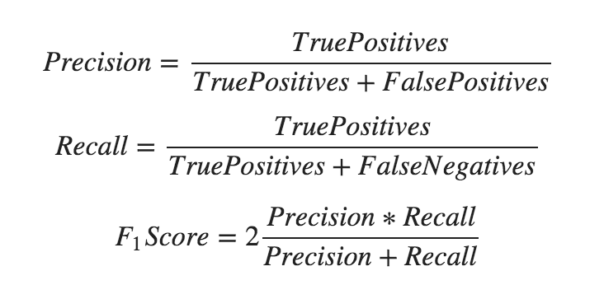
Evaluating Model Performance (cont.)
Other metrics
Accuracy
Precision
Recall
F-score
Dataset not balanced / uniformly distributed
Notes:
Teddy
Due to class imbalances, we did not use accuracy as a good measure. Precision alone would be able to help us correctly identify when someone would click on an ad, but wouldn’t be able to capture all of the other clicks they may be making on a web page. Recall was also considered, as a high recall score would identify all of the ads being clicked on, but we were worried that wouldn’t capture the right amount of precision. Then we considered the F1 score to balance the trade-off between precision and recall. The f-1 score calculates the harmonic mean between precision and recall and is more specific for the model’s specific probability threshold, which doesn’t tell us the same thing as the area under curve. Hence why we went with area under curve Precision-Recall curve.
Next slide.
include ROC curve pic of our model when ready
score = area under the curve
plots False Positive Rate relative to True Positive Rate
can tune the threshold to determine how many false positives we can tolerate in order to increase the number of true positives that we capture
could focus more effort and advertising dollars on the individuals that we are very confident that they will click

Slide 14
Implementation
Data in parquet format
Single Fold Logistic Regression
K-fold cross validation (K=10)
K-fold cross validation with class weights
Other models
Random Forest
Gradient Boosted Tree
Notes:
Brent

Slide 15
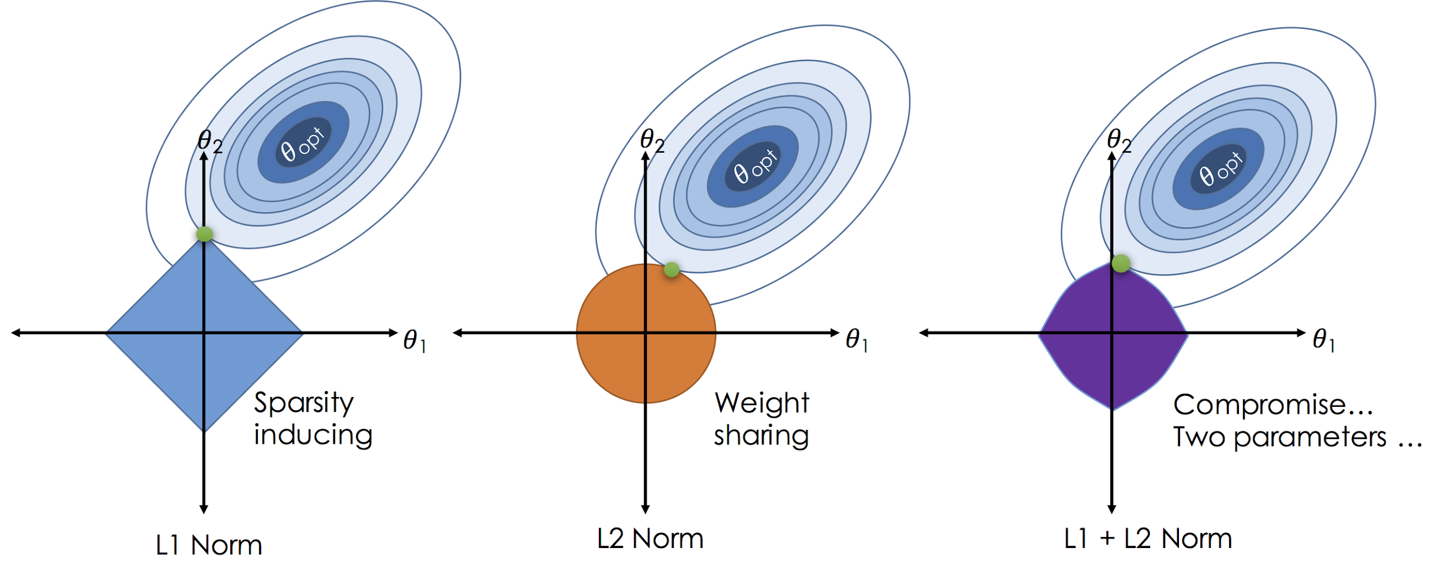
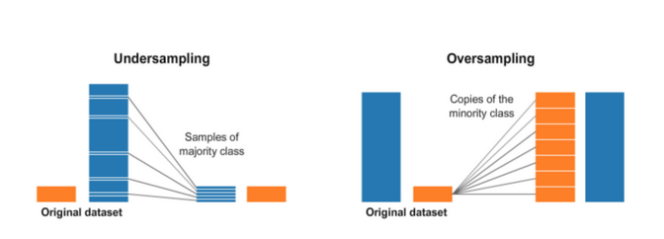
Implementation
Grid Search Across Regularization Parameter and Elastic Net Parameter
Account for imbalance in dataset through use of class weights
Notes:
Brent

Slide 16
Results
Area under the PR curve scores:
 | Train | Validation
Single Fold | 0.615 | 0.612
K-Fold | 0.615 | 0.612
K-Fold with adjusted threshold | - | 0.416
K-Fold with class weights | 0.412 | 0.410

Slide 17
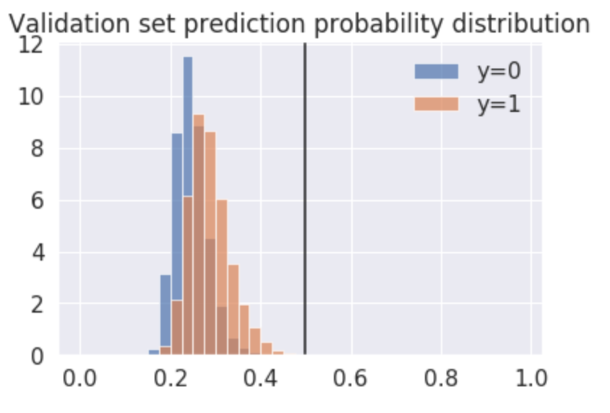
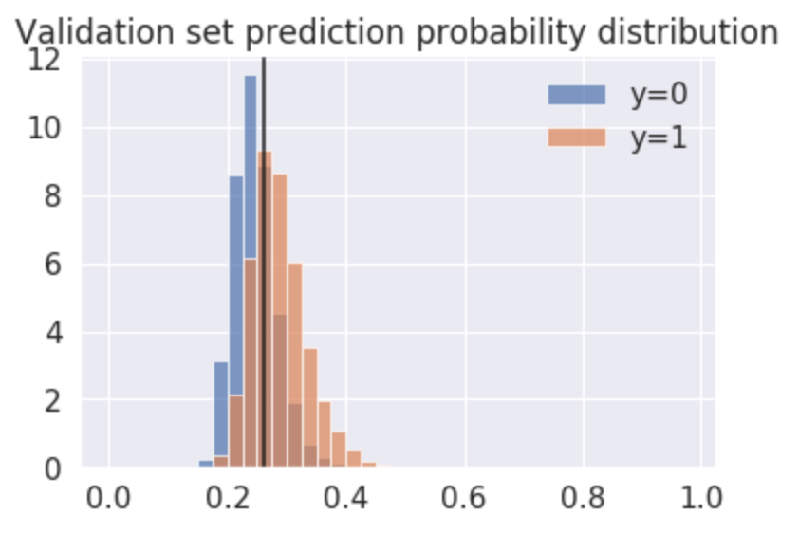
Thresholds
Found best threshold using maximum F-score
Threshold decision should be based on the balance between cost of false positives and false negatives
Threshold = 0.5
Threshold = 0.26

Slide 18
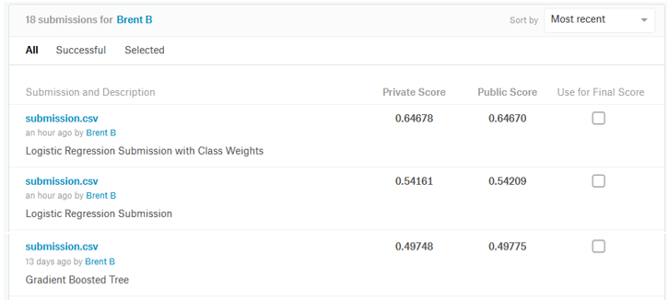
Kaggle Results
While we see better performance in terms of the Precision Recall curve for Logistic Regression, the best “Kaggle Score” was obtained for a gradient boosted tree model
Notes:
Brent

Slide 19
Course Concepts
Big Data Scalability - Spark
ML Lib
One-hot Encoding
Sparse Representation
Overfitting / Model Regularization
Feature Selection and it's effect on Model Complexity
Notes:
Brent

Slide 20

Questions
Brent Biseda: brentbiseda@berkeley.edu
Theodore Fong: theodorefong@berkeley.edu
Thanh Le: thanh@berkeley.edu
Katie Mo: kmo@berkeley.edu
Notes:
Brent

Slide 21
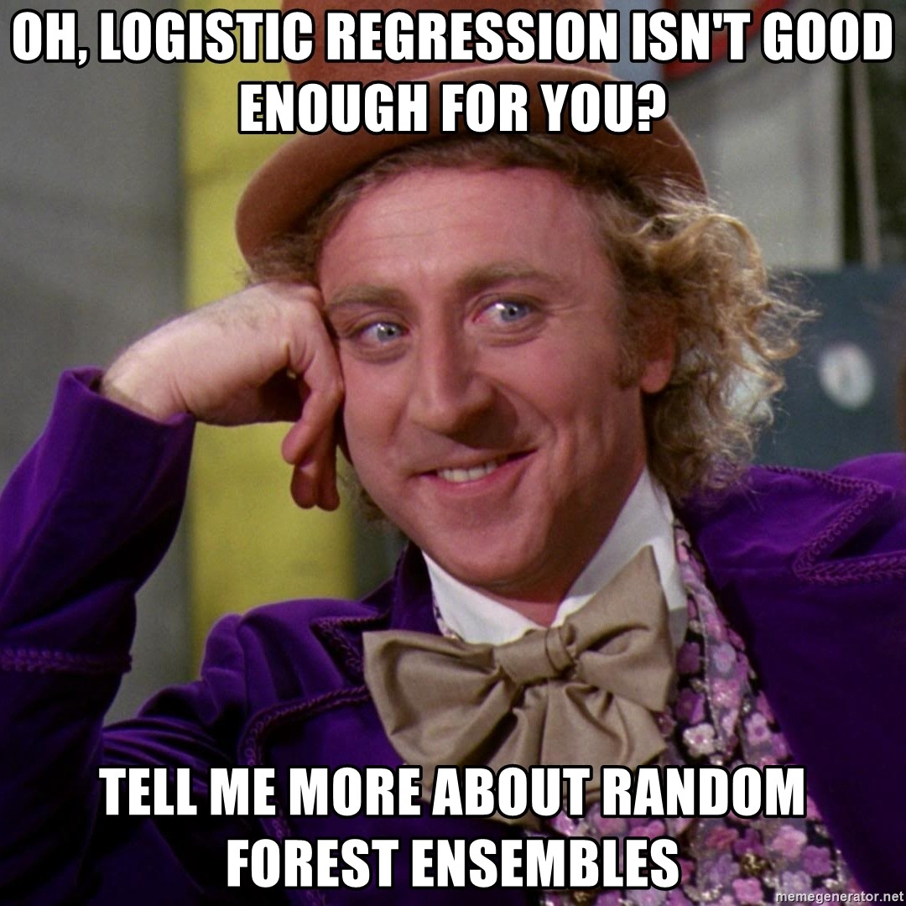
Notes:
Brent

Slide 22
Backup Slides

Slide 23
CSV vs. Parquet
Parquet
designed to more efficiently store columnar data
can be queried more efficiently with SQL
optimized to minimize file I/O and efficiently compresses
computation charges are correspondingly lower as well
Notes:
Thanh

Slide 24
One-hot Encoding
Difficult to accurately train model with categorical variables
Convert categorical data into numerical representations
Scaling Features – for use with Regularization
Notes:
Katie

Slide 25
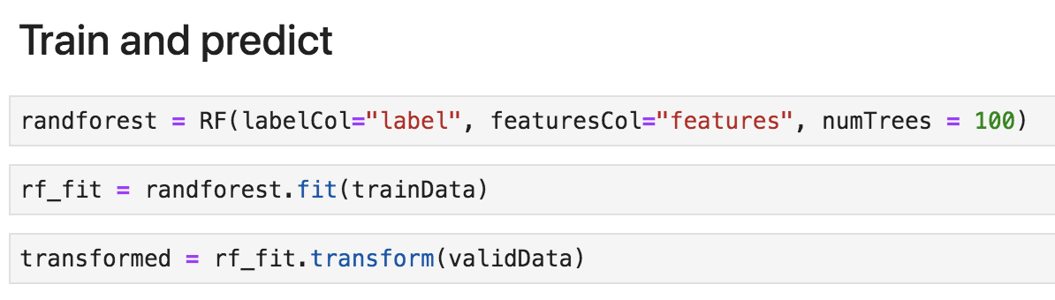
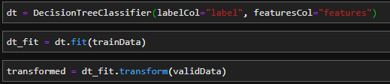
Alternative(s) Explored
Random Forest
Decision Tree
Notes:
Teddy

